Slide 1
Employee Data Analysis using Excel
STUDENT NAME: ASHOK.K
REGISTER NO: 312200418
DEPARTMENT: 3rd B.COM CA
COLLEGE: S.I.V.E.T COLLEGE

Slide 2
PROJECT TITLE
Employee Performance Analysis using Excel

Slide 3


AGENDA
Problem Statement
Project Overview
End Users
Our Solution and Proposition
Dataset Description
Modelling Approach
Results and Discussion
Conclusion
3/21/2024 Annual Review

Slide 4

PROBLEM STATEMENT
A problem statement is an overview of a challenge you're facing that explains an issue's cause, impact, and potential solutions

Slide 5

PROJECT OVERVIEW
.A project view is a way to look at project data by focusing on specific aspects of a project. Different project management tools offer different views, such as: Microsoft Project: Offers a variety of views, including Gantt charts, network diagrams, sheets, usage, and forms. You can access the most common views from the View menu or the icons on the View bar. VirtualSpace: Offers a layout that allows you to view project activities and tasks.

Slide 6

WHO ARE THE END USERS?
End users are the people who use a product or service, and in the case of an Excel project, they may be the people who use the project's data or results

Slide 7

OUR SOLUTION AND ITS VALUE PROPOSITION
To effectively outline your solution and its value proposition in an Excel project, you can use a structured approach.
Problem ID: Unique identifier for each problem. Problem Description: Detailed description of the problem. Impact: How the problem affects the target audience or business.

Slide 8
Dataset Description
When describing a dataset in an Excel project, it's important to include several key components to provide a clear understanding of the data and its context. Here's a structured approach to crafting a dataset description:

Slide 9

THE "WOW" IN OUR SOLUTION
To make your Excel project stand out, consider incorporating some advanced features or techniques that showcase your skills and provide added value. Here are a few ideas:
3/21/2024 Annual Review
9

Slide 10
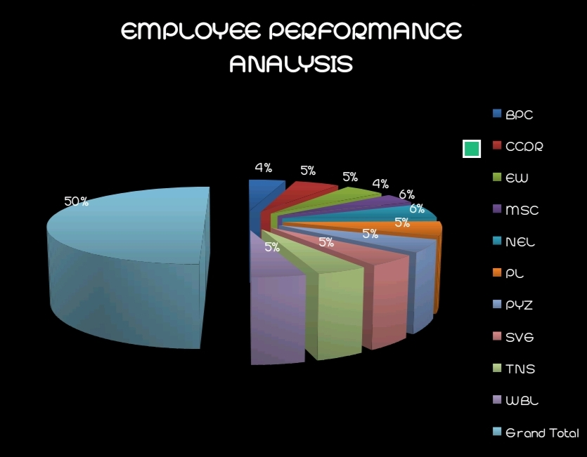
MODELLING
10

Slide 11
RESULTS
Create a Results Sheet: Set up a dedicated sheet for displaying results and summaries.Use Clear Labels: Clearly label each section of the output for easy understanding.
11

Slide 12
conclusion
In an Excel project, a conclusion typically summarizes the key findings, insights, and implications derived from the data analysis. Here’s a general structure.
Summarize Key Findings: Briefly restate the most important results.
Interpret the Results: Explain what the findings mean in the context.
Implications: Discuss the practical implications of your findings.

